Slide 1
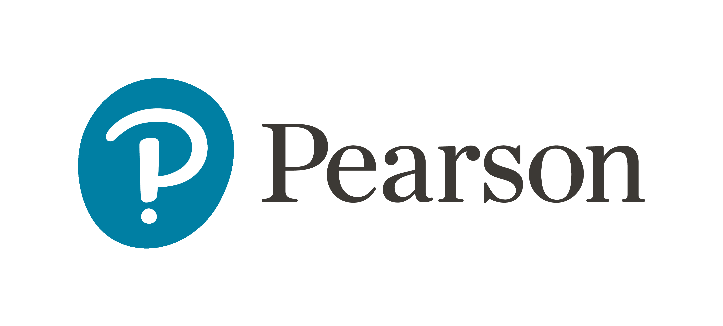
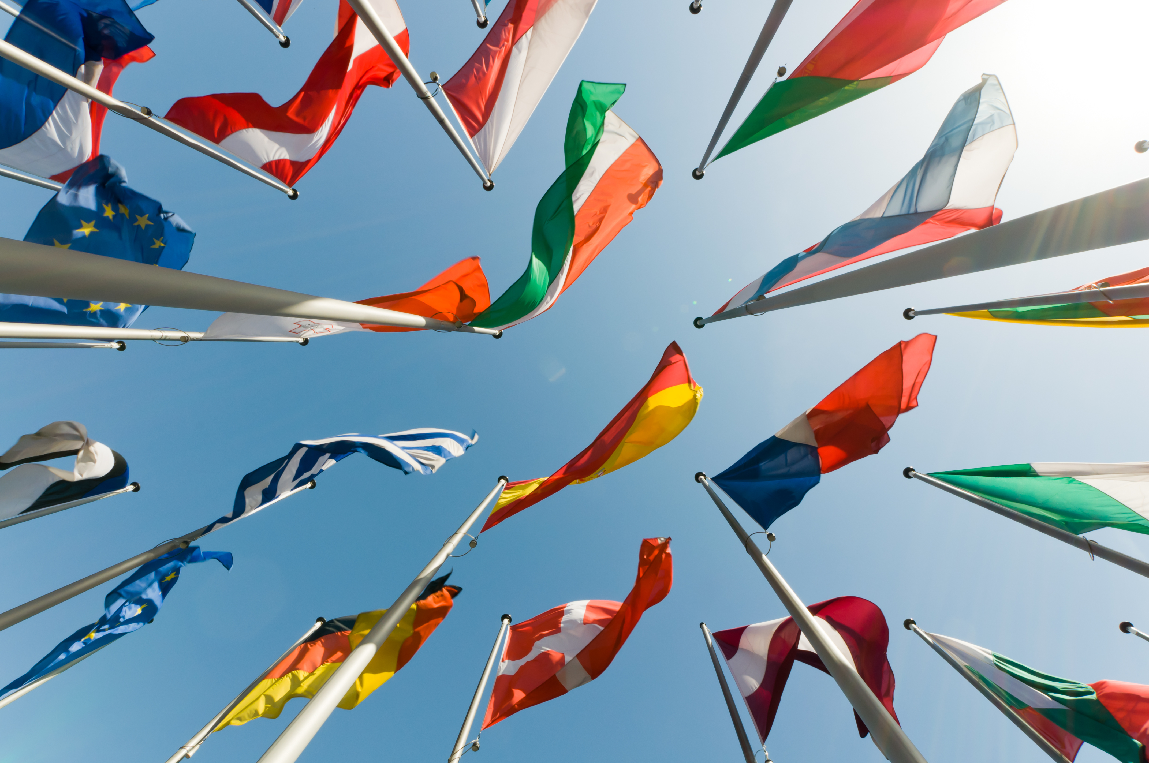
European Day of Languages Celebration
Pick and mix activities to celebrate language diversity
C0490 Version 1.0 • July 2022

Slide 2
European Day of Languages Celebration
How to play: instructions for teachers
Dip into these pick and mix language activities as starters, stand-alone activities or for a whole lesson. Some activities may also be suitable for flipped learning or homework.
Answers are provided after each activity.
Keep track of student scores if you wish to find and reward an overall class winner.
Pick and mix menu
2

Slide 3
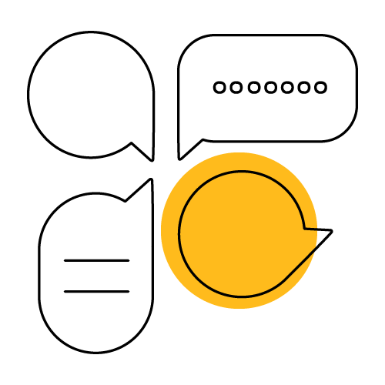
Pick and mix menu
5. Say hello!
1. A-Z of languages
6. Fun facts: true or false
2a. Top 10: European round
7. Words travel
2b. Top 10: Global round
8. Coin a word
3. Quick quiz
9. Language discovery
4. Social languages
10. Favourite words

Slide 4
Team round
1 A-Z of languages
Write the alphabet, A-Z, in the margin of your book.
Work in teams to write down the names of as many different languages as you can think of for each letter in English.
Option: do this activity in another language that you speak or that you are learning – or in a mix of languages!
A.
B.
C.
D.
E. English
F.
G.
H.
I.
J.
K.
L.
M.
N.
O.
P.
Q.
R.
S.
T.
U.
V.
W.
X.
Y.
Z.
Go to answers

Slide 5
Possible answers
1 A-Z of languages
Score 10 points per language.
50 bonus points for completing at least 20 letters.
100 bonus points for a language for all 26 letters.
A. Arabic, Afrikaans
B. Bulgarian
C. Cantonese, Czech, Croatian
D. Danish, Dutch
E. English
F. French, Finnish
G. Greek, German, Gujarati
H. Hebrew, Hungarian, Hindi
I. Indonesian, Italian
J. Japanese
K. Korean
L. Latvian, Lithuanian
M. Mandarin
N. Norwegian
O. Occitan
P. Portuguese, Persian, Polish
Q. Québécois French
R. Russian, Romanian
S. Spanish, Swedish
T. Turkish
U. Urdu, Ukrainian
V. Vietnamese
W. Welsh
X. Xhosa
Y. Yoruba, Yiddish
Z. Zulu
Check with your teacher if you have other answers.
Back to the menu

Slide 6
2a Top 10: European round
Put the most spoken languages in Europe in order.
Polish
Italian
Approximate number of native speakers | Language
1. 160 million
2. 97 million
3. 72 million
4. 65 million
5. 63 million
6. 47 million
7. 39 million
8. 33 million
9. 24 million
10. 22 million
English
Ukrainian
French
Romanian
Spanish
German
Russian
Dutch
Go to answers

Slide 7
Answers
2a Top 10: European round
Put the most spoken languages in Europe in order.
Approximate number of native speakers | Language
1. 160 million | Russian
2. 97 million | German
3. 72 million | French
4. 65 million | Italian
5. 63 million | English
6. 47 million | Spanish
7. 39 million | Polish
8. 33 million | Ukrainian
9. 24 million | Romanian
10. 22 million | Dutch
10 points for each correct match.
Play Global round
Back to the menu
Notes:
Source: Langoly, with 2022 data pulled from a variety of sources, including Ethnologue, the UK census and European government bodies. https://www.langoly.com/most-spoken-languages-in-europe/. Rounded up to nearest million.

Slide 8
2b Top 10: Global round
Put the most spoken languages in the world in order.
Urdu
Arabic
Total number of speakers | Language
1. 1.5 billion
2. 1.1 billion
3. 602.2 million
4. 548.3 million
5. 274.1 million
6. 274 million
7. 272.7 million
8. 258.2 million
9. 257.7 million
10. 231.3 million
English
Portuguese
French
Hindi
Spanish
Bengali
Russian
Mandarin Chinese
Go to answers

Slide 9
Answers
2b Top 10: Global round
Put the most spoken languages in the world in order.
Total number of speakers | Language
1. 1.5 billion | English
2. 1.1 billion | Mandarin Chinese
3. 602.2 million | Hindi
4. 548.3 million | Spanish
5. 274.1 million | French
6. 274 million | Arabic
7. 272.7 million | Bengali
8. 258.2 million | Russian
9. 257.7 million | Portuguese
10. 231.3 million | Urdu
10 points for each correct match.
Back to the menu
Notes:
Source: https://www.ethnologue.com/guides/ethnologue200, for total language usage worldwide, including people who speak these languages as their native tongue and those who speak them as second languages.

Slide 10
Team round
3 Quick quiz
1. What are the three 'working languages' of the EU Commission (used in meetings, official documents etc.)?
2. How many official EU languages are there? a. 12 b. 18 c. 24
3. Approximately how many regional/minority languages are used in Europe? a. 65 b. 85 c. 105
4. In Spain, there is a language called Silbo gomero made up only of: a. yodelling b. whistling c. clicking
5. What is the name of the artificial language devised in 1887 as an international means of communication? a. Esperanto b. Spanglish c. Anpean
Go to answers

Slide 11
Answers
3 Quick quiz
1. What are the three 'working languages' of the EU Commission (used in meetings, official documents etc.)? English, French and German
2. How many official EU languages are there? c. 24
3. Approximately how many regional/minority languages are used in Europe? a. 65
4. In Spain, there is a language called Silbo gomero made up only of: b. whistling
5. What is the name of the artificial language devised in 1887 as an international means of communication? a. Esperanto
10 points per correct answer for each student on the team.
Back to the menu
Notes:
Source for question 3: https://www.academia.edu/13977360/Minority_Languages_in_Multilingual_European_Union​
Silbo gomero video and article: https://www.bbc.co.uk/news/magazine-20953138

Slide 12
4 Social languages
Option 1
Write a social media post in a language that's not English to share a positive message about languages and language-learning.
For example:
Explain why knowing other languages is important.
Encourage people to start learning a new language.
Option 2
Create a video to talk about one or all of these topics in a foreign language:
Which languages you speak, understand or are learning.
Which languages you would like to learn and why.
Your best language-learning experience – in or out of school.
Your top tips to get better at languages.
100 points for a post or video.
Back to the menu

Slide 13
5 Say hello!
Match the greetings to the language.
Japanese
Arabic
Hello translations | Language
1. Bonjour
2. أهلا
3. Ciao
4. 안녕하세요
5. Hola
6. こんにちは
7. Hallo
8. Χαίρετε
9. Olá
10. Habari
Greek
Portuguese
French
Italian
Spanish
German
Swahili
Korean
Go to answers

Slide 14
Answers
5 Say hello!
Click on the links to practise your pronunciation of each greeting.
Hello translations | Language
1. Bonjour | French
2. أهلا | Arabic
3. Ciao | Italian
4. 안녕하세요 | Korean
5. Hola | Spanish
6. こんにちは | Japanese
7. Hallo | German
8. Χαίρετε | Greek
9. Olá | Portuguese
10. Habari | Swahili
10 points for each correct match.
100 bonus points if you learn to say all 10 correctly.
Back to the menu
Notes:
Source: https://translate.google.co.uk/

Slide 15
Team round
6 Fun facts: true or false?
1. Papua New Guinea has the most languages in use.
2. There is only one sign language used worldwide.
3. The world's longest alphabet has 74 letters.
4. E is the most common letter in English.
5. German is the fastest language in the world (syllables spoken per second).
6. The most languages spoken by one person is 59.
7. English has more words in the dictionary than any other language.
8. There are about 7,000 languages spoken globally.
Go to answers

Slide 16
Answers
6 Fun facts: true or false?
1. True: Papua New Guinea has 840 languages in use.
2. False: There are about 300 sign languages in use.
3. True: Khmer (Cambodia's language) has 74 letters.
4. True: E is the most common letter in English.
5. False: Japanese is the fastest language in the world (7.84 syllables spoken per second).
6. True: Ziad Youssef Fazah can communicate in 59 languages.
7. False: Korean has the most words in a dictionary (1.1 million).
8. True: About 7,000 languages are spoken globally.
10 points per correct answer for each student on the team.
Back to the menu
Notes:
Source: https://www.kiwi.com/stories/fun-facts-world-languages/

Slide 17
7 Words travel
Which language do these words come from?
Sanskrit
Italian
English word | Language of origin
1. Anonymous
2. Cigar
3. Cartoon
4. Entrepreneur
5. Penguin
6. Loot
7. Avatar
8. Lemon
9. Ketchup
10. Karaoke
Arabic
Japanese
French
Welsh
Spanish
Chinese
Greek
Hindi
Go to answers

Slide 18
Answers
7 Words travel
Which language do these words come from?
English word | Language of origin
1. Anonymous | Greek
2. Cigar | Spanish
3. Cartoon | Italian
4. Entrepreneur | French
5. Penguin | Welsh
6. Loot | Hindi
7. Avatar | Sanskrit
8. Lemon | Arabic
9. Ketchup | Chinese
10. Karaoke | Japanese
10 points for each correct match.
Back to the menu
Notes:
Source: https://cudoo.com/blog/something-borrowed-english-words-with-foreign-origins/

Slide 19
8 Coin a word
All these words have been added to dictionaries in recent years.
iel
– French gender-neutral pronoun
Abstandsbier
– German term for socially-distanced beer
Invent your own word(s) in a language of your choice.
hygge
– English word from Danish culture meaning cosy
finde
– Spanish abbreviation for weekend (fin de semana)
10 points for each new word with a definition.
Back to the menu

Slide 20
9 Language discovery
Find out about a language of your choice and present your research.
Is this an official language for a particular country or countries?
Where else is this language spoken?
How many people speak this language?
Choose 5-10 words or short phrases you’d like to learn in this language and find out how to write them and say them.
Find out some fun facts about your chosen language.
Create a slogan and logo to promote your chosen language.
Create a poster, factsheet, video or presentation.
100 points per project.
Back to the menu

Slide 21
10 Favourite words
Make a list of your favourite words in a language of your choice.
Here are some of our favourites:
French examples
vachement = slang for ‘really'
la chauve-souris = bat (literally, 'bald-mouse')
German examples
Kuddelmuddel = jumble/mess
Luftschloss = an unrealistic dream (literally, 'air castle')
Spanish examples
tiquismiquis = picky/fussy
madrugar = to get up early
10 points per word.
Back to the menu

Slide 22
Thank you for taking part!

