Slide 1
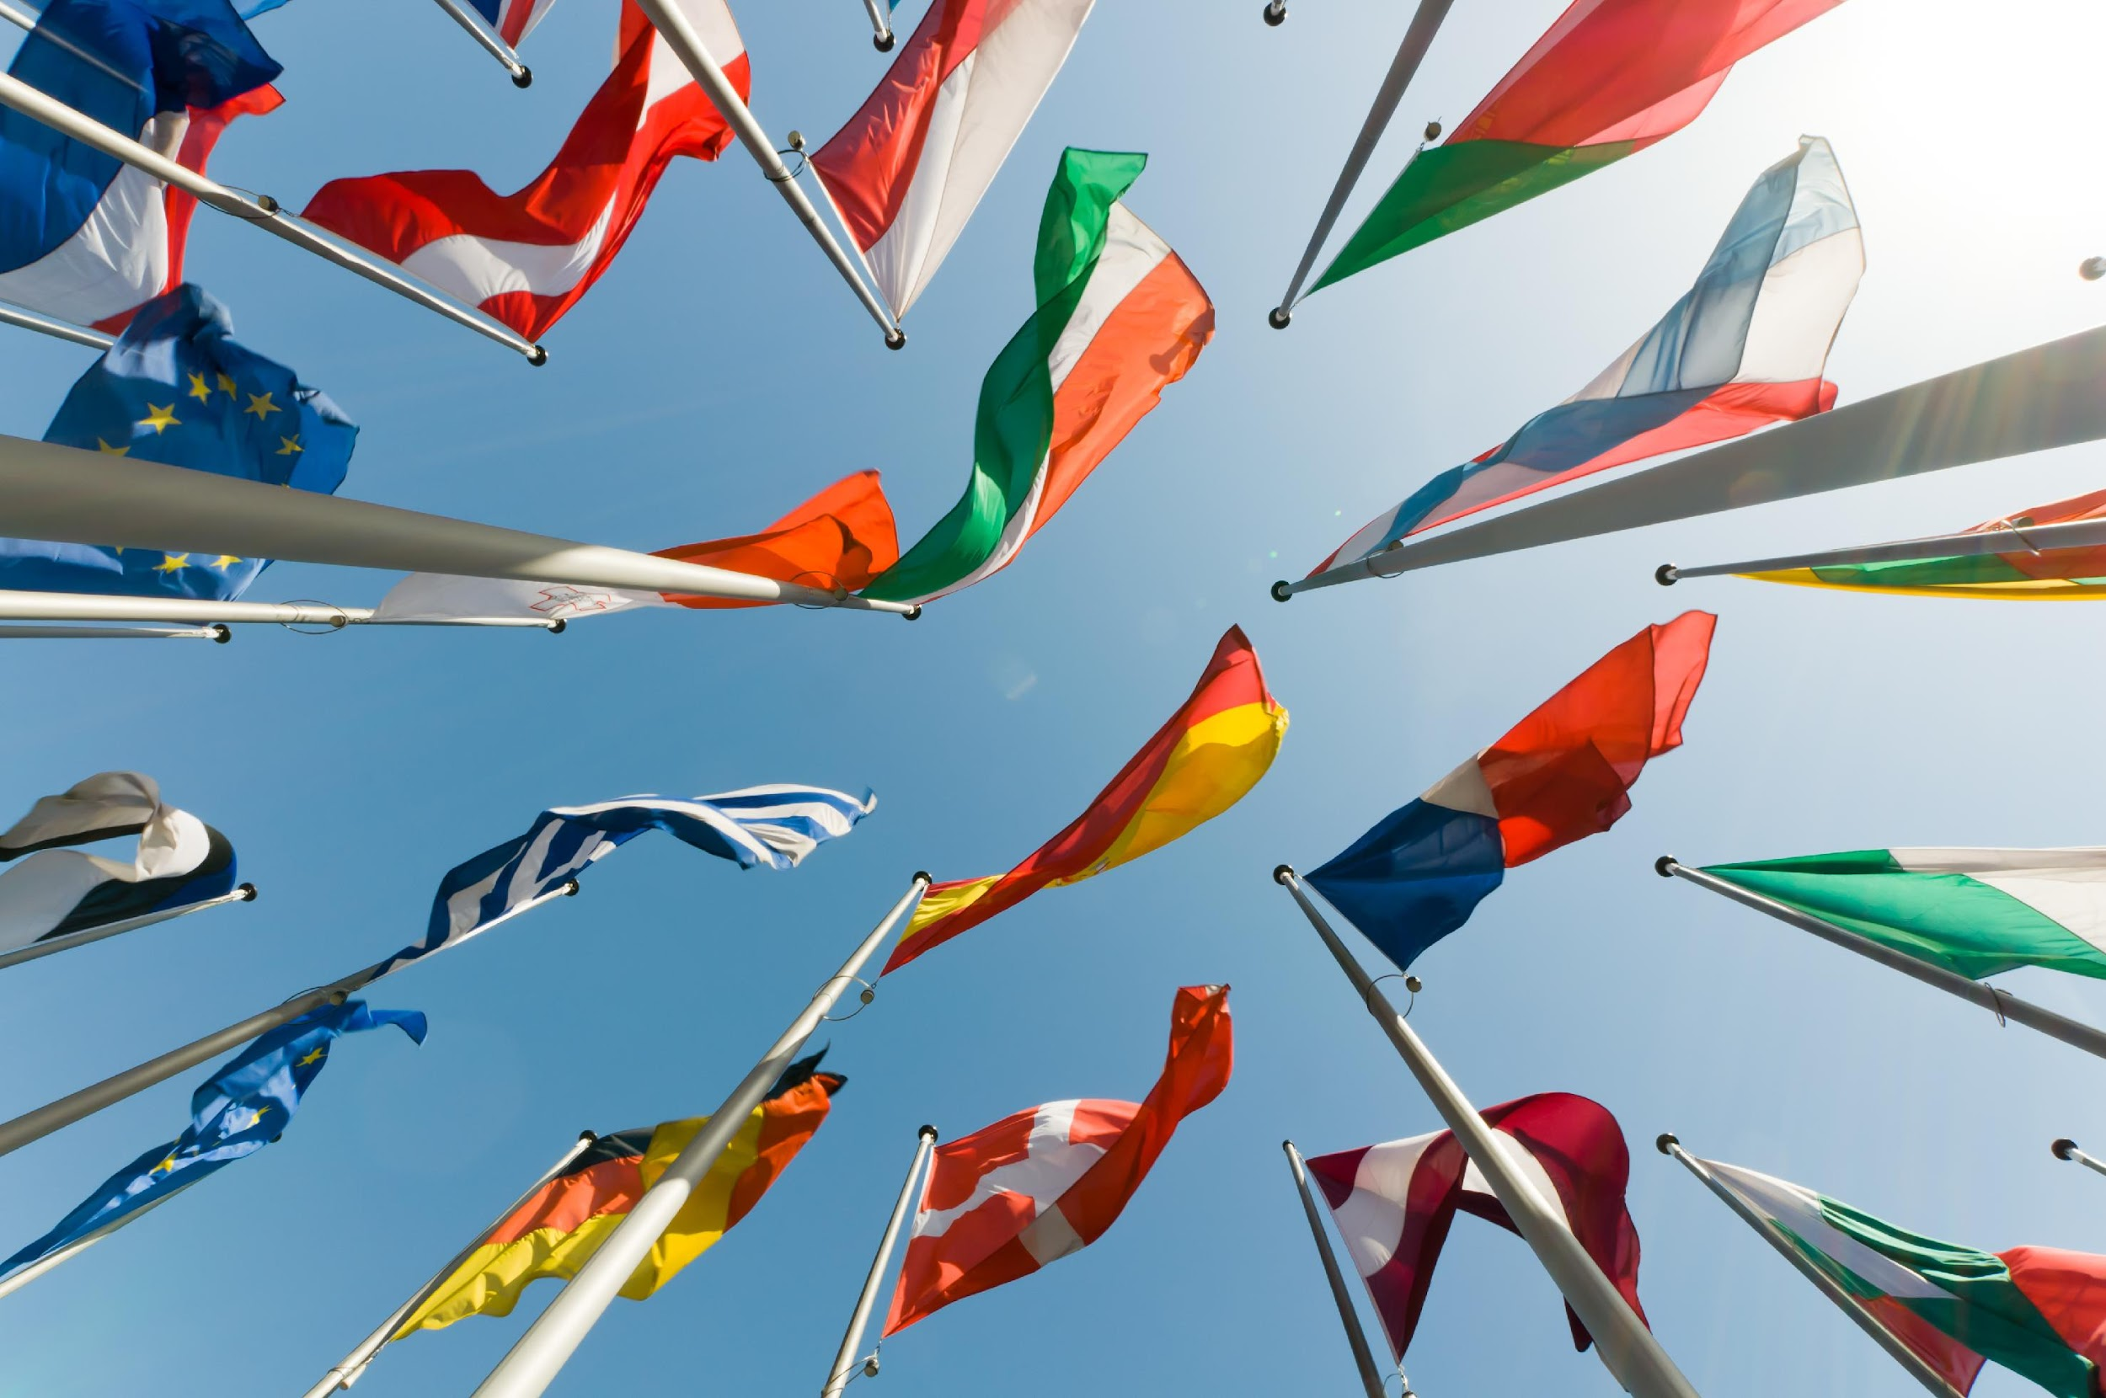
A Summer of Sport
A selection of language activities to celebrate a summer of sport
UNTITLED TEXT

Slide 2
Celebrating a summer of sport
This summer will see multiple international sporting events, capturing the gaze of millions across the globe.
What better way to inspire learning a new language than preparing to speak to tourists, athletes and fans, discussing what to see, who you are, as well as celebrating and making friends.
To celebrate a summer of sport, we’ve built a selection of fun games and classroom activities for you to try with your students.
2

Slide 3
Celebrating a summer of sport
How to play: instructions for teachers
Dip into these language activities as starters, stand-alone activities or for a whole lesson. Some activities may also be suitable for flipped learning or homework.
Answers are provided after each activity.
Some tasks include printable PDF.
Keep track of student scores if you wish to find and reward an overall class winner.
Pick and mix menu
2

Slide 4
6. Who is your mascot?
Language activity
menu
7. Team up!
1. Bonjour from Paris!
8. Stadium snacks
2. Sport word search
9.Auf geht's! Let’s go!
3. Allez les langues!
10. Guten tag from Germany!
4. Say hello!
11. Broadcasting to the world!
5. Welcome! What is your story?
12. Where next?
Notes:
Links will need to be added

Slide 5
Bonjour from Paris!
Explore greetings, introductions, and basic questions in French.
Role-play scenarios like welcoming tourists or asking for directions around Paris.
Example scenarios:
‘We need directions to the Arc D’Triomphe, could you help?’
‘Do you know a good Boulangerie on the way to the Eiffel Tower?’
‘How do we get to the Stade De France, do we take a metro?’
‘Can you tell me the best way to get to Musee D’Orsay?’
‘Welcome to Paris, where do you need to go?’

Slide 6
2. Sport word search
.
A | T | H | L | É | T | I | S | M | E | T | G
W | G | B | M | I | E | K | L | U | B | V | Y
R | E | W | Q | P | N | L | X | S | D | N | M
T | Y | U | I | O | N | P | A | E | S | A | N
C | K | K | J | H | I | G | F | L | D | T | A
L | Y | Z | A | B | S | N | M | I | M | A | S
P | O | C | I | A | U | Y | T | O | R | T | T
P | L | K | L | V | J | H | G | V | F | I | I
E | S | C | R | I | M | E | T | A | J | O | Q
N | M | D | A | R | S | S | O | N | U | N | U
E | W | C | R | O | F | M | O | N | D | E | E
A | F | C | B | N | G | T | E | V | O | L | I
Can you find 9 French words for:
Athletics
Cycling
Rowing
Fencing
Gymnastics
Judo
Swimming
Tennis
Sailing

Slide 7
2. Sport word search
.
A | T | H | L | É | T | I | S | M | E | T | G
W | G | B | M | I | E | K | L | U | B | V | Y
R | E | W | Q | P | N | L | X | S | D | N | M
T | Y | U | I | O | N | P | A | E | S | A | N
C | K | K | J | H | I | G | F | L | D | T | A
L | Y | Z | A | B | S | N | M | I | M | A | S
P | O | C | I | A | U | Y | T | O | R | T | T
P | L | K | L | V | J | H | G | V | F | I | I
E | S | C | R | I | M | E | T | A | J | O | Q
N | M | D | A | R | S | S | O | N | U | N | U
E | W | C | R | O | F | M | O | N | D | E | E
A | F | C | B | N | G | T | E | V | O | L | I
Athletics - Athlétisme
Cycling - Cyclisme
Rowing - Aviron
Fencing - Escrime
Gymnastics - Gymnastique
Judo - Judo
Swimming - Natation
Tennis - Tennis
Sailing - Voile

Slide 8
3. Allez les langues! Let's go languages!
Name as many countries participating in the summer games, the name of the country in their own language and the language they speak.
COUNTRY | NAME | LANGUAGE
France | La France (République Française) | Francais / French
Germany | Deutschland | Deutsch / German

Slide 9
4. Say hello!
Match the greetings to the language.
Japanese
Arabic
Hello translations | Language
1. Bonjour
2. أهلا
3. Ciao
4. 안녕하세요
5. Hola
6. こんにちは
7. Hallo
8. Merhaba
9. Olá
10. Habari
Turkish
Portuguese
French
Italian
Spanish
German
Swahili
Korean

Slide 10
4. Say hello!
Click on the links to practise your pronunciation of each greeting.
Hello translations | Language
1. Bonjour | French
2. أهلا | Arabic
3. Ciao | Italian
4. 안녕하세요 | Korean
5. Hola | Spanish
6. こんにちは | Japanese
7. Hallo | German
8. Merhaba | Turkish
9. Olá | Portuguese
10. Habari | Swahili
Notes:
Source: https://translate.google.co.uk/

Slide 11
5. Welcome! What’s your story?
In a chosen language, students can create their own sports story, explaining who they are, what part of the world they are from, what sport they are competing in, what they are most excited about and what they hope to see while they are in Paris.
Use this interaction to not only practice basic phrases, but also descriptive conversation.
6. Who is your mascot?
In a chosen language, students can pick a team taking part at the Olympics and design their own mascot..
Explain who the mascot is, what animal they are, and why they have chosen them.
For example: The German mascot could be Bart the Bear, who has been designed to inspire children across the world to get active and encourage a love of sport and its values.

Slide 12
7. Team up!
This summer, 24 national football teams will play to be the best in Europe. For this task, give your students a group of nations and set them tasks, for example:
What language do they speak.
The countries capital city.
One interesting fact about each country.
An interview scenario, between a TV presenter and player.
GERMANY
SCOTLAND
HUNGARY
SWITZERLAND
SPAIN
CROATIA
ITALY
ALBANIA
SLOVENIA
DENMARK
SERBIA
ENGLAND
POLAND
NETHERLANDS
AUSTRIA
FRANCE
BELGIUM
SLOVAKIA
ROMANIA
UKRAINE
TÜRKIYE
GEORGIA
PORTUGAL
CZECHIA

Slide 13
8. Stadium snacks
Research popular snacks from Germany and other participating countries, writing a description in their original language, followed by a description in English. Starter ideas: bratwurst / pommes frites / bolsa de pipas
Snack Name (MFL) | Description (MFL) | Snack Name | Description

Slide 14
9. Auf geht's! Let’s go!
Match the German football saying with their English translation!
Click the link below for a PDF copy of this task: Auf geht’s! Let’s Go!
Deutsch | English
Abseits!
Auf geht's!
Elfer!
Rot
Gelb
Gut gehalten
JAAAAAAAAAAA!!!
Schiri
Schnell
TOOOOOOOOORRRRRRRRR!!!!

Slide 15
9. Auf geht's! Let’s go!
Click the link below for a PDF copy of this task: Auf geht’s! Let’s Go!
Deutsch | English
Abseits! | Offside!
Auf geht's! | Let’s Go!
Elfer! | Penalty!
Rot | Red
Gelb | Yellow
Gut gehalten | Well saved!
JAAAAAAAAAAA!!! | Yessss!
Schiri | Ref
Schnell | Quick
TOOOOOOOOORRRRRRRRR!!!! | Goooaaaalllll!!!!

Slide 16
10. Guten tag from Germany!
Explore greetings, introductions, and basic questions in German. Role-play scenarios like welcoming tourists or asking for directions around Berlin.
Help with directions to the local museum
Welcoming tourists to Berlin
Invent your own scenarios to explore greetings!
Can you recommend some good spots for lunch?
What way to the U-Bahn?

Slide 17
11. Broadcasting to the world!
Roleplay as a TV presenter explaining what is happening across Europe this summer of sport.
Explore where sports are being held, what sports are taking place, who is competing, and what exciting things tourists can do around the sports taking place.
12. Where next?
In a chosen language, teams of students can pitch why their chosen country should be the host of the next Olympic / Paralympic games in 2028!
This task will allow them to explain to explain what city the games will be held in, why it is important to the chosen country and what parts of the culture will be exciting for athletes and spectators to experience.

Slide 18
Thank you for taking part!

